Slide 1
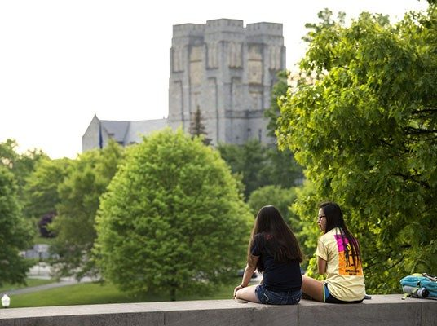


100 Years
of Excellence
Introducing the history of the department of Agricultural, Leadership, and community education

Slide 2
1917 - 19
Virginia Tech Student Population: 477
Department Location: Agricultural Education Building
Joseph Eggleston President from 1913 – 1919

Slide 3
1917-19
Quotes from VPI Board of Visitor’s Minutes
I recommend that Prof. Dabney S. Lancaster be elected Professor of Agricultural Education and Animal Husbandry, at a salary of $2,600..; $1,600 of this salary to be paid from the State Smith - Hughes Fund and $1,000 to be paid from the College Fund (April 3, 1918).
These amounts (from the Smith-Hughes Act)… being considerably less than we had anticipated it seemed necessary to cut down the budgets… In the department of agricultural education we thought it best to drop Assistant professor Cale and to readjust the salary of Professor E. C. Magill, these two items affecting an economy of $1,625.00. This still leaves us about $4,000 short of the amount we need… (October 8, 1920).
1918 Dabney Lancaster named first department head of Agricultural Education and Animal Science

Slide 4
1920s
VT Student Population: 798
Department Location: Agricultural Education Building
First girls on campus in 1921
Women’s basketball team started and called the Turkey Hens
Freshman football team called the Goblets
Julian Burruss President 1919 - 1929

Slide 5
1920s
1924 Student census showed 54 students majoring in Agricultural Education.
1925 V. P. I IS HOST TO VOCATIONAL H. S. STUDENTS
The Agricultural Rally of last week-end came to a climax Saturday night at seven o’clock in a mass meeting of the visiting vocational high school students. Prizes were awarded in the athletic and agricultural contests. Chase City took the first place in athletics while Windsor excelled in agriculture (The Virginia Tech, April 30, 1925).
September Walter Newman, Edmund Magill, Harry Sanders, and Henry Groseclose proposed the idea of the Future Farmers of Virginia. They sat at an oak table located in the Agricultural Education House (near what is currently the Drillfield).
E. C . Magill appointed department head

Slide 6
1930s
VT Student Population: 1,817
Department Location: Agricultural (Price) Hall
Julian Burruss President 1919 - 1945

Slide 7
1930s
1932-33 VPI Collegiate FFA Chapter chartered with Henry Groseclose serving as adviser
1934 Departmental name changed to Department of Vocational Education with Harry Sanders as leader. Lyle Kinnear added to departmental faculty to work with and teach general education and psychology courses. In 1972 Dr. Kinnear would publish a historical book for the Virginia Tech centennial entitled “The First 100 Years.”
1938 Miss Olive Salem appointed first female faculty member in the department as a research assistant.

Slide 8
1940s
VT Student Population: 3,582 (1943: 982, 1944: 738)
Department Location: Agricultural (Price) Hall
In-State Tuition - $120 per year
The Campus Prepares for War II
Julian Burruss President 1919 - 1945
John Redd Hutcheson President 1945 – 1947

Slide 9
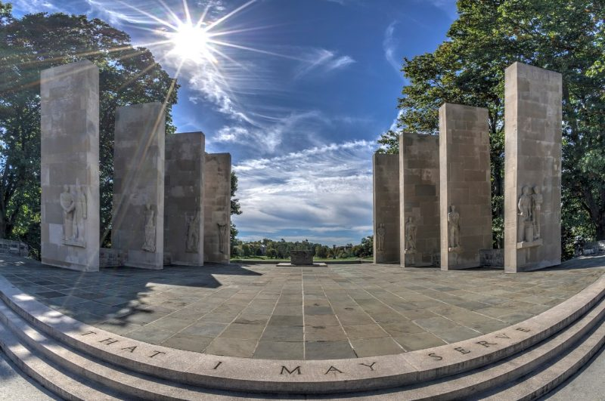

The decade of the 1940s was dominated by World War II. Because of VPI’s reputation for its ROTC program and the Corps of Cadets, the United State’s Military wanted as many officers as possible and came to Blacksburg to find them. Consequently, in 1942 the first ever commencements were held for the fall and winter quarters.
1940s

Slide 10
1940s
1940 Edmund Magill died during the 14th VA FFA Association State Convention
Harry Sanders replaced Magill as department head
1946 T. J Wakeman appointed to teach farm mechanics courses
1947 Walter Newman appointed president of VPI where he would serve until 1962.
1949 T. J. Horne appointed to faculty and designated department head

Slide 11
1950s
VT Student Population: 4,786
Departmental Location: Smyth Hall
In-State Tuition - $456
Students permitted to drive on campus 1951
Hillcrest known as the Skirt Barn where coeds lived
Students on GI Bill lived in small trailers by Stadium Woods
Stuart Cassell, former FFV state officer and for whom Cassell Coliseum was named, served as VPI business manager
World War II Memorial completed 1953
First black student, Irving L. Pedrrew III, admitted 1953

Slide 12
1950s
1952 Miss Olive Salem resigned as research assistant
1953 B. C. Bass granted leave of absence to work on his doctorate at Penn State University
1954 E. G. Thompson given leave of absence to work on his doctorate
1956 C. E. Richards went to Egypt to work with the Egyptian Minister of Education to develop an agricultural education teacher training program.

Slide 13
1960s
VT Student Population: 7,711
Departmental Location: Derring Hall
In-State Tuition - $390
Cassel Coliseum completed 1964
Lane Stadium opened 1965
African-American women admitted 1966
T. Marshall Hahn President 1962 - 1974

Slide 14
1960s
1960 E. G. Thompson appointed head of Agricultural Education replacing T. J. Horne, who was appointed Director of Resident Instruction for the College of Agriculture .
1962 Agricultural Education administratively part of School of Science and General Studies
1965 John Rodgers appointed head of Agricultural Education when E. G. Thompson was appointed director of admissions for VPI.
    The department FFA table displayed at the National FFA Convention when the New Farmers of America merged with the Future Farmers of America.
1968 J. Dale Oliver appointed head of Agricultural Education.
    Glenn Anderson served as Virginia Tech senior class president
1969 Alfred Krebs appointed head of Agricultural Education when John Rodgers resigned to move to Clemson.

Slide 15
1970s
VT Student Population: 19,314
Departmental Location: Derring Hall, War Memorial Hall, & Lane Hall
In-State Tuition - $540
Faculty Senate started
Collegiate Times student newspaper 1971
Earth Day celebrated 1971
William Lavery President 1975 - 87

Slide 16
1970s
1970 Collegiate FFA Chapter disbanded and Agricultural Education Society established with John Crunkilton serving as advisor.
1971 The College of Education was formed with four divisions. Agricultural Education became a program area within the Division of Vocational and Technical Education.
1973 First doctoral degree awarded to Panya Hiranrusme

Slide 17
1980s
VT Student Population: 22,044
Departmental Location: Derring Hall, War Memorial Hall, & Lane Hall
In-State Tuition - $1,680
Blacksburg Transit System started - 1983
College of Engineering required students purchase a computer - 1984
William Lavery President 1975 - 1987
James McComas President 1988 - 1994

Slide 18
1980s
1980 With an initial donation from Agricultural Education Society of $300 to the Virginia Tech Foundation the departmental scholarship program started with the first scholarship honoring Harry Sanders.
1981 The Agricultural Education Society FFA Leadership Conference started with an initial attendance of 366 FFA Members.
The first Harry Sanders scholarship was awarded to recipient Allen Talbert.
1982 Virginia Tech FFA Historical Room Started

Slide 19
1990s
VT Student Population: 26,645
Departmental Location: Litton-Reaves
In-State Tuition - $3,500
James McComas President 1988 - 1994
Paul Torgerson President 1994 - 2000

Slide 20
1990s
1991 With a formal memorandum of understanding completed, the Agricultural Education Program Area was administratively moved from the College of Education to CALS. The new program was physically located in Litton-Reaves. This move permitted the program to start the process of recapturing its own degrees, students, courses, budget, & departmental status.
1993 The 75th anniversary of Virginia Tech was held. Activities included a banquet, open house, and a meeting of alumni.
1994 A contract was established with the Virginia Department of Education to provide services to the Virginia FFA Association and FFA Advisors. The first FFA executive secretary and a faculty member in the department.
1998 The Residential Leadership Community (RLC) was started as part of the Department of Interdisciplinary Studies and later would move administratively to the Department of Agricultural Leadership and Community Education.

Slide 21
2000s
Virginia Tech Student Population: 28,470
Departmental Location: Litton-Reaves
In-State Tuition - $4,958
Tragic Shooting Killing 32 faculty and students - April 16, 2007
Charles Steger President 2000 - 2014

Slide 22
2000s
2000 Two curriculum specialist positions were established with funding coming from the Commonwealth of Virginia with flow through money from the Virginia Department of Agriculture and Consumer Services.
The Virginia Governor’s School for Agriculture was started. It was funded as part of the Gifted Program for the Virginia Department of Education.
2001 The Agricultural Education Program was merged with Extension Program and Development Unit to form the Department of Agricultural & Extension Education
2002 Three online courses, among the first in the College of Agriculture and Life Sciences, were offered in the department.
2003 The 85th anniversary departmental brunch was held with nearly 100 participants.
2006 A bachelor’s degree in Agriscience was approved by the Virginia State Council of Higher Education.
2007 New graduate level degrees established including: Master’s of Life Sciences, Leadership Masters, and Leadership Ph. D

Slide 23
2010s
VT Student Population: 34,470
Departmental Location: Litton-Reaves
In-State Tuition - $13,620
Charles Steger President 2000 - 2014
Timothy Sands President 2014 - present

Slide 24
2010s
2010 The College of Agriculture and Life Sciences approved the establishment of a leadership program called Virginia Agriculture Leaders Obtaining Results or VALOR.
2015 VALOR program recognized with the National Association of Agricultural Educators Outstanding Postsecondary Adult Agricultural Education Program Award.
2018 Dedication of renovated O’Shaughnessy Hall as a residential dormitory for the Residential Leadership Community.
Endowed departmental funds, including scholarships, reached 1.25 million dollars
Centennial celebration for department

